Slide 1
Simple Diffusion: end-to-end diffusion for high resolution images
Authors: Emiel Hoogeboom, Jonathan Heek, Tim Salimans
Alberto Becerra Tomé
Barcelona, May 2024

Slide 2
Table of Contents
Motivation
Related Work
Diffusion Models
Experiments
SOTA Models Comparison
Conclusions
Notes:
We are going to cover the motivation, of the work, the experiments performed in it and the conclusions which can be extracted.

Slide 3
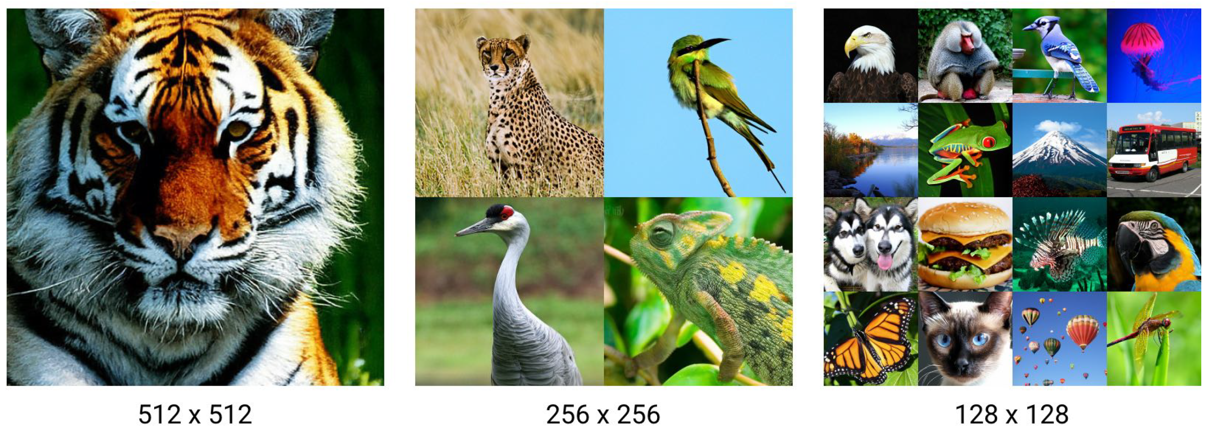
Motivation
Train standard Diffusion Models on high-resolution images
Modify hyperparameters and architecture design to obtain similar performance than for lower resolutions
Notes:
Diffusion models have proven highly effective for generating images, audio, and video. This work seeks to enhance noise reduction in high-resolution images without overcomplicating the model. It revolves around a key question: Is it possible to train conventional diffusion models on high-resolution images and achieve results as effective as those from alternative methods?

Slide 4
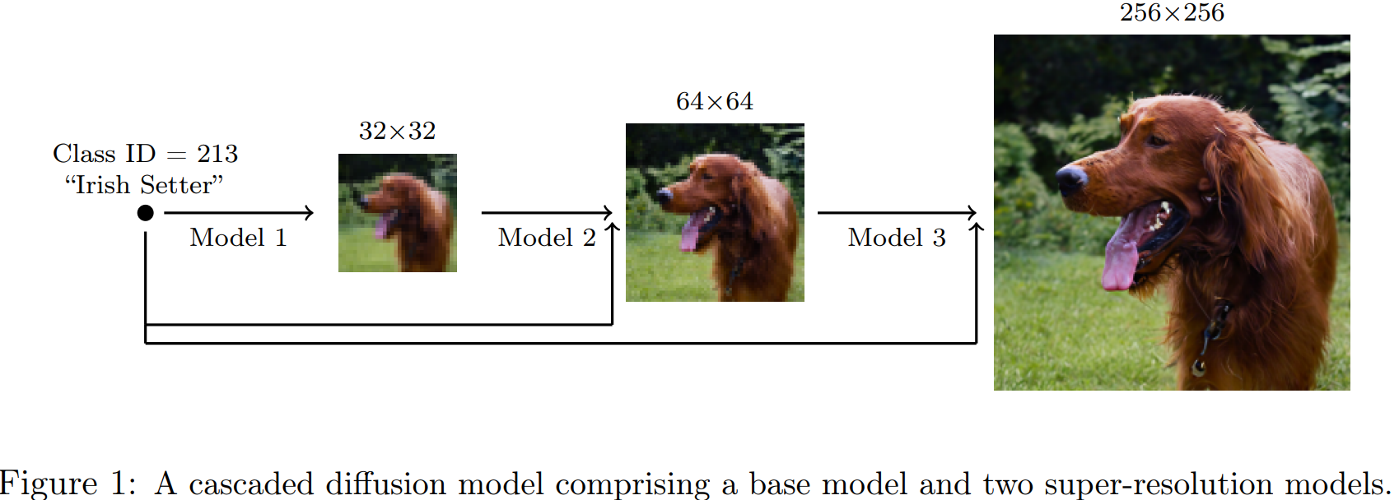
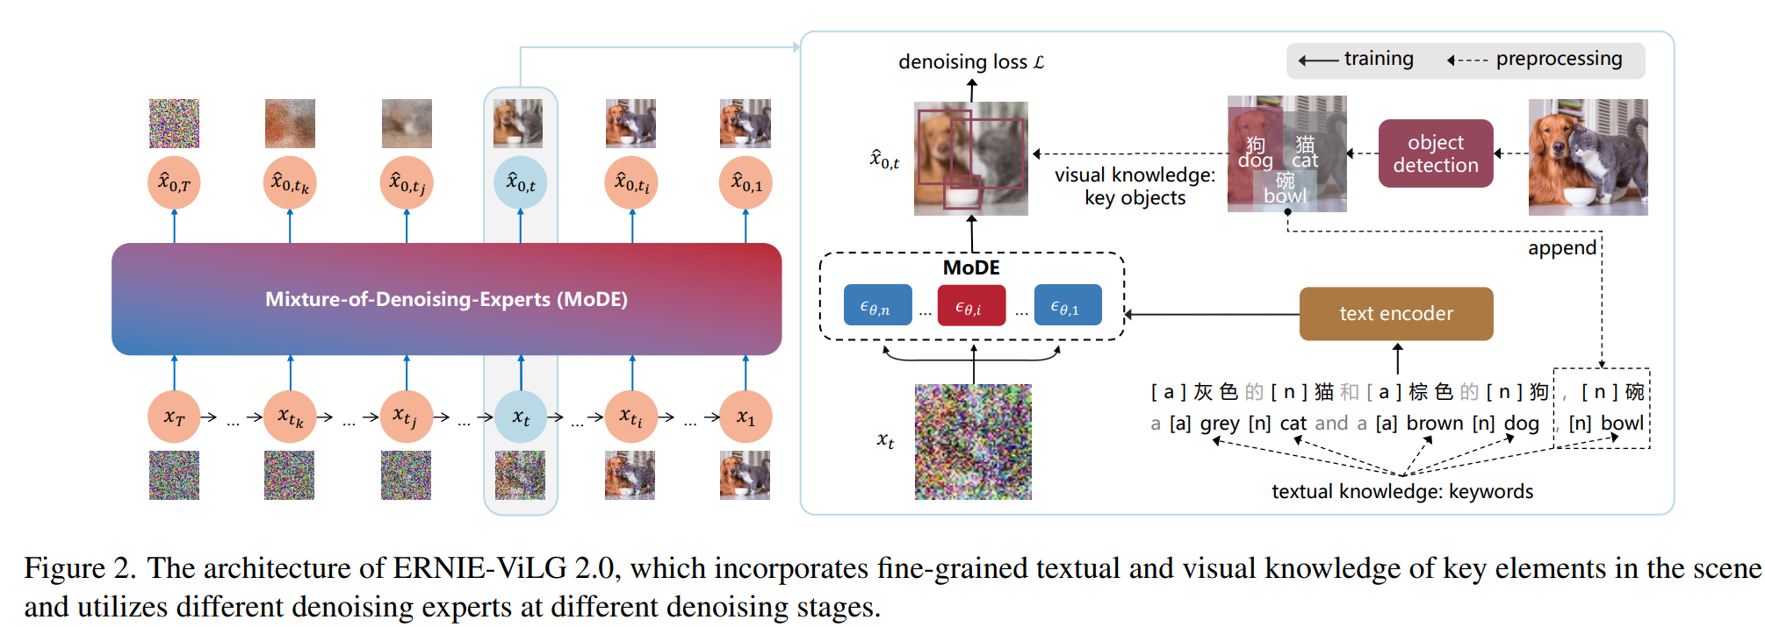
Related Work
Super- Resolution
(Ho et al., 2022)
Mixtures-of-Denoisers
(Feng et al., 2022; Balaji et al., 2022)
* Fig 1: Ho, J et al. Cascaded diffusion models for high fidelity image generation. J. Mach. Learn. Res., 23:47:1–47:33, 2022.
** Fig 2: Feng, Z., et al. Ernie-vilg 2.0: Improving text-to-image diffusion model with knowledge-enhanced mixture-of-denoising-experts. CoRR, abs/2210.15257, 2022.
Notes:
The drawback of existing techniques is that they add complexity and generally do not allow for a straightforward end-to-end training approach.
The authors show that it is possible to train a single denoising diffusion model for resolutions up to 512 × 512 with only a small number modifications with respect to the original (modern) formulation in (Ho et al., 2020)

Slide 5
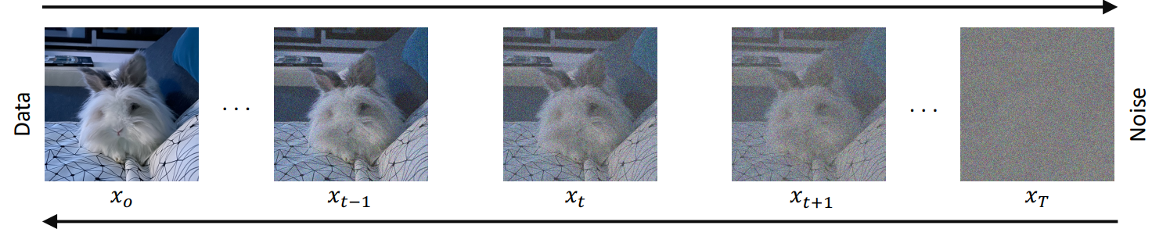
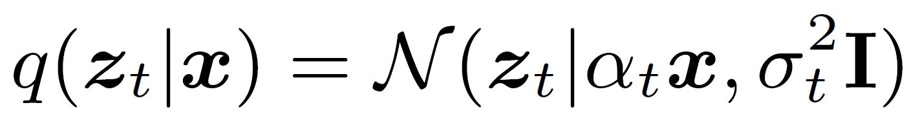
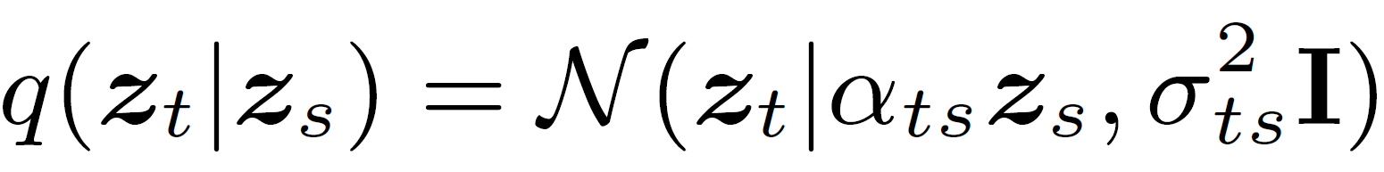
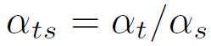
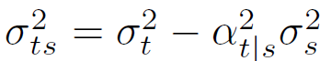
Diffusion Models
z
z
z
z
z
Forward Process: a Markov Chain where Gaussian noise is added in successive steps
to obtain a set of noisy samples.
Process at timestep t
Transitions (Markov)
Image Credits: https://arxiv.org/abs/2209.04747
Notes:
Diffusion models are a type of deep generative model that have recently drawn considerable interest in computer vision due to their impressive ability to generate images with fine details and high diversity.
The unique aspect of diffusion models is their probabilistic framework, which involves learning to reverse a process that adds increasing levels of noise to the training data. This approach has two main stages: forward diffusion and backward denoising.
In forward diffusion, noise is gradually added to the original images over a series of steps, degrading them to the point where they look like pure Gaussian noise.
If we consider this process as Markovian then we can parametrize the transition probabilities as follows.

Slide 6
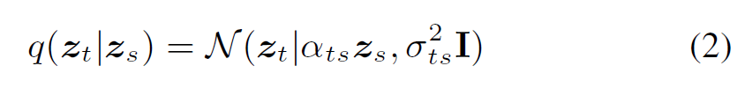
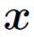
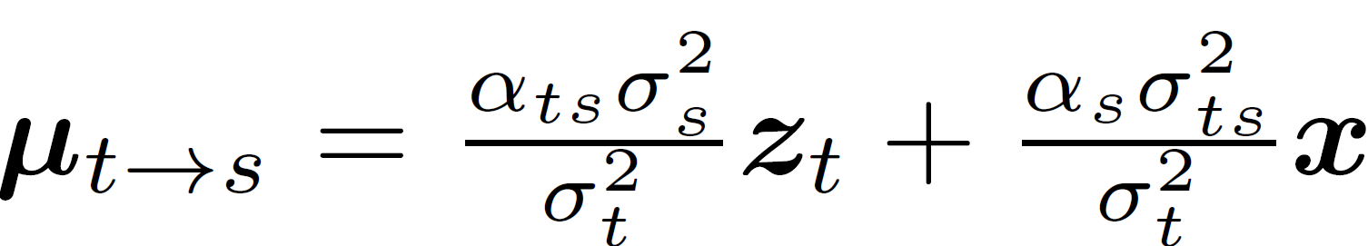
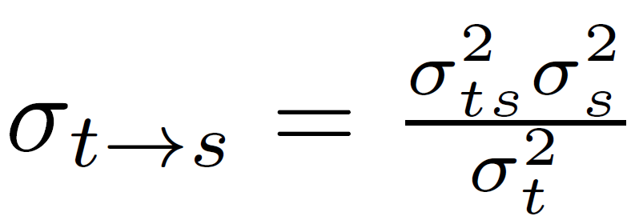
Diffusion Models
z
z
z
z
z
Forward Process: a Markov Chain where Gaussian noise is added in successive steps
to obtain a set of noisy samples.
Reverse Process: Conditioned on a single data point x ,
Image Credits: https://arxiv.org/abs/2209.04747
Notes:
The subsequent backward denoising phase reverses this process, iteratively removing noise to reconstruct the original images. At inference, images are generated by gradually reconstructing them from random white noise, with the noise removal at each step estimated by a neural network, typically utilizing a U-Net architecture, to maintain dimensional coherence.

Slide 7
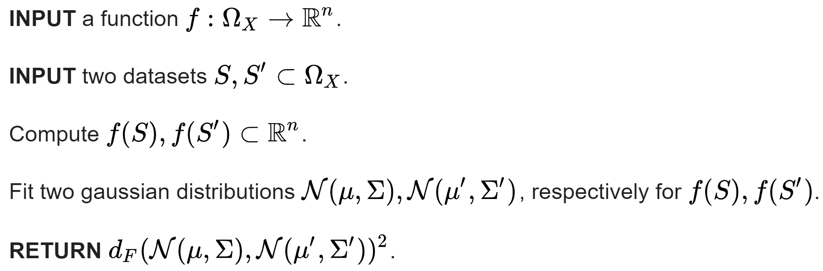
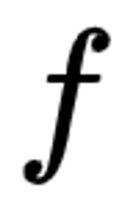
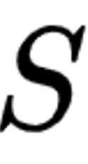
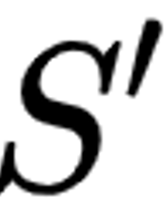
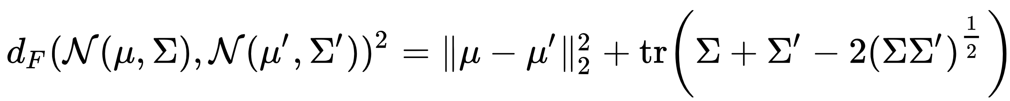
Experiments: Setup
Experiments have been performed on ImageNet
The evaluation metric is Fréchet inception distance (FID)
2048-dimensional activation vector of InceptionV3 last pooling layer
Reference dataset (ImageNet)
Generated images
Notes:
Experiments are performed on ImageNet, a standard in visión models benchmarking.
A widely used metric for image generation is Fréchet Inception Distance. It basically compares the distance of the 2048 size features obtained after applying InceptionV3 backbone to a reference dataset and the generated images, fit gaussians on them and computing Frechet distance.

Slide 8
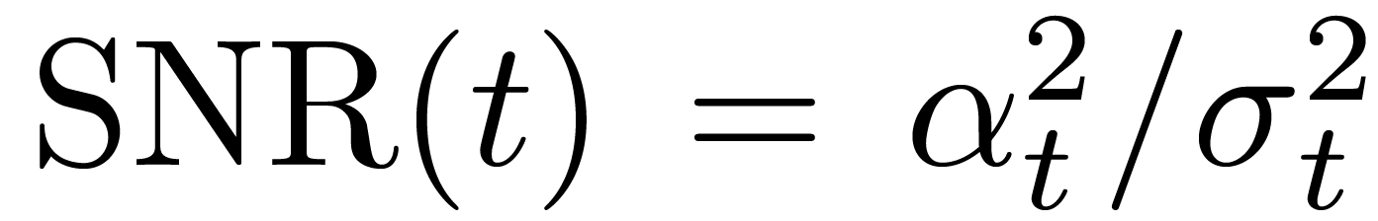
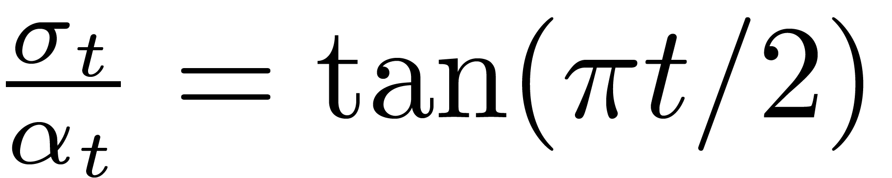
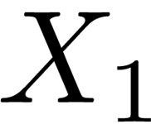
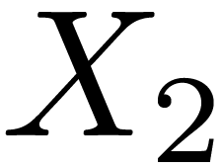
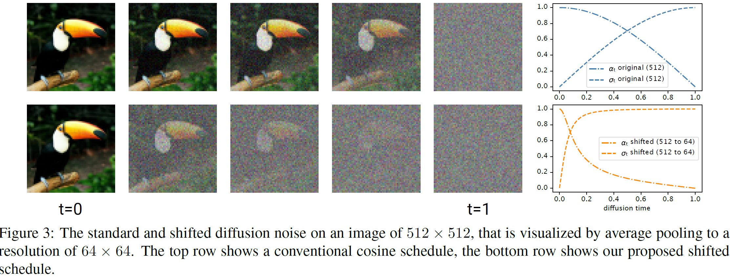
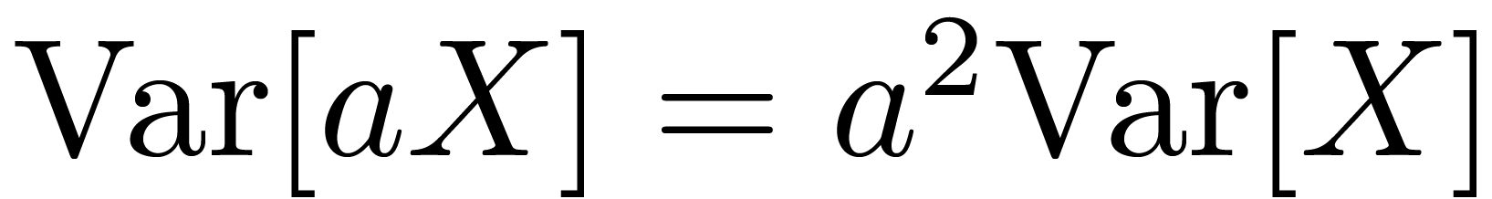
Experiment 1: Noise Schedule.
Original Noise Ratio (Typically for 64x64)
Given and i.i.d (independent)
For 128x128, after a size 2 Average Pooling,
Solution:
Notes:
The α-cosine noise schedule is commonly used in diffusion models for image generation, as it maintains consistent variance through the diffusion process. It was initially designed for low-resolution datasets like CIFAR10 (32x32) and ImageNet (64x64). However, for higher-resolution images, this schedule may not add enough noise early in the process, leading to issues in denoising.
For example, when applying this schedule to a 128x128 image, it was observed that the image structure becomes visible early on in the diffusion process, suggesting that the generative model has less time to make global decisions. This is because it undergoes downsampling to a 64x64 image via average pooling. The diffusion distribution of the downsampled pixels has half the noise variance, creating a higher signal-to-noise ratio.
The signal-to-noise ratio for a downsampled image of size 𝑠×𝑠 is 𝑠^2 times greater than the full-sized image. Given this effect, we can adjust the noise schedule to compensate for higher resolutions.

Slide 9
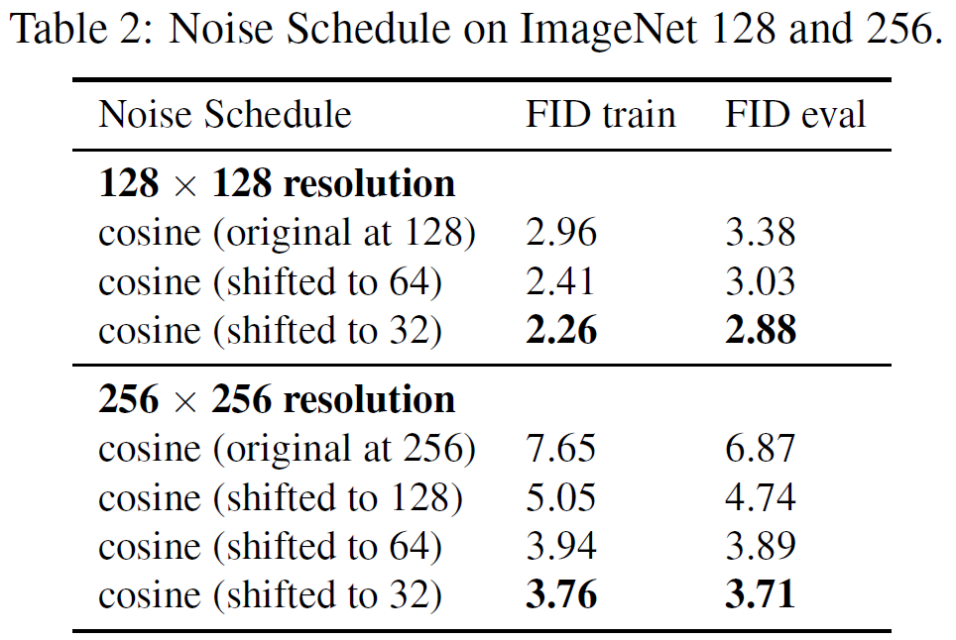
Experiment 1: Noise Schedule.
Hypothesis: the cosine schedule does not add sufficient noise, but can be adjusted by ‘shifting’ its log SNR curve using the ratio between the image resolution and the noise resolution.
Notes:
As can be seen in Table 2 for ImageNet at resolution 128 × 128 and resolution 256 × 256, shifting the noise schedule considerably improves performance. The difference is especially noticeable at the higher resolution, where the difference is 7.65 for the original cosine schedule against 3.76 for the shifted schedule in FID on the train data. Notice that the difference in performance between the shift towards either 64 and 32 is relatively small, being slightly better for the 32 shift.

Slide 10
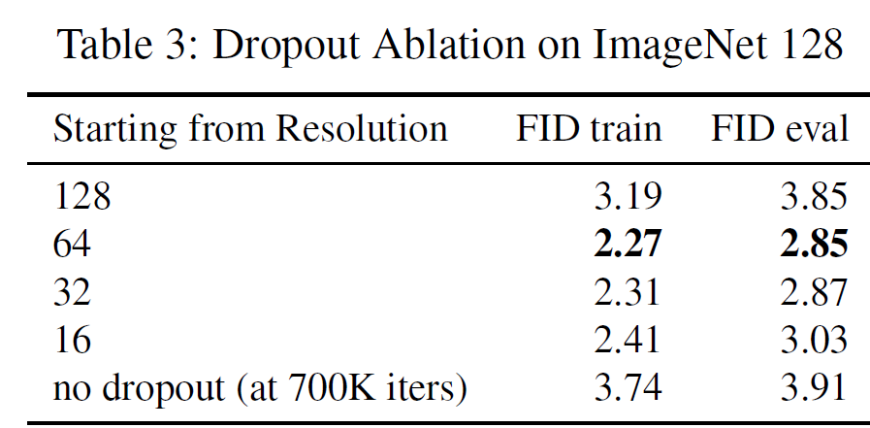
Experiment 2: Dropout.
Hypothesis:
For big datasets such as ImageNet, regularization is necessary even for high resolutions
Dropout from lower resolution feature maps improve results
Notes:
Dropout, where we randomly turn off certain nodes during training, is a popular method, but it’s typically avoided in high-resolution models due to performance concerns.
Instead of applying dropout throughout the whole network, it was used selectively. A 'starting resolution’ is set to define where dropout begins. For example, if the starting resolution is 32x32, we applied dropout only to layers at 32x32, 16x16, and 8x8 resolutions. This approach leaves the higher-resolution layers intact, reducing the risk of overfitting without sacrificing model stability.
Applying dropout, in every case, did it better than not applying it.
When we applied dropout starting at 64, 32, or 16 in experiments with 128x128 images, the outcomes were similar.
Two things can be noticed: First, applying no dropout at all leads to overfitting. Second, starting dropout at the same resolution as the data is too aggressive, leading to instability.

Slide 11
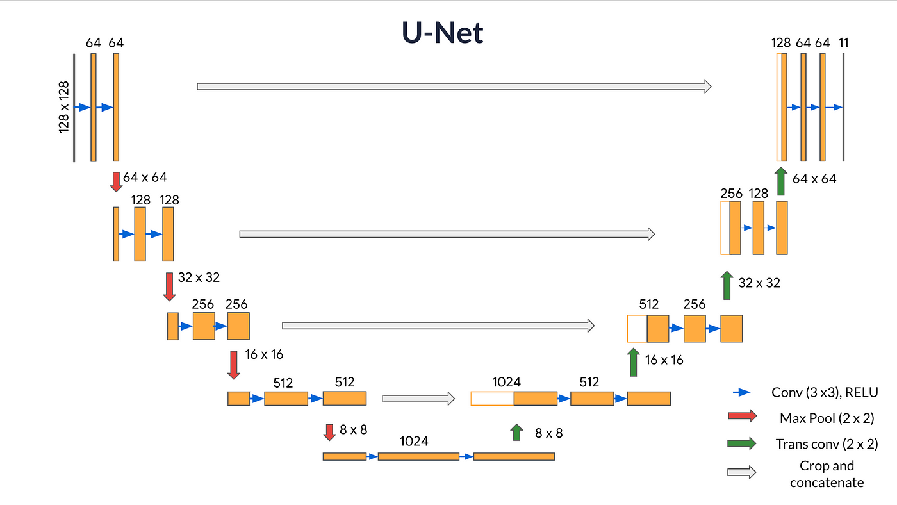
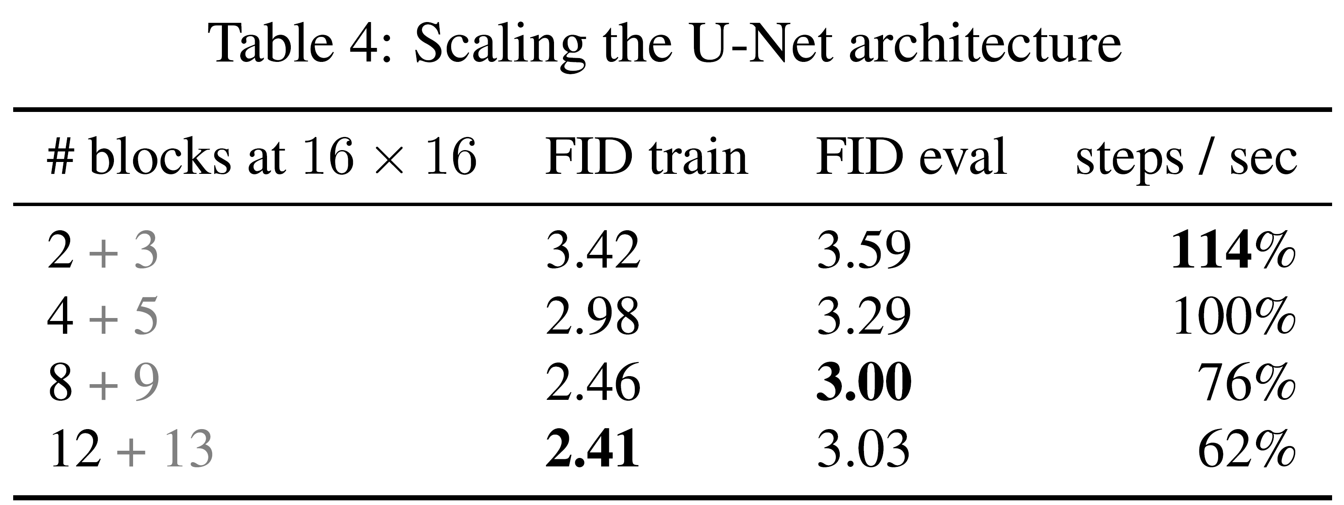
Experiment 3: U-Net Architecture Scaling.
Hypothesis: mainly scaling on a particular resolution, namely the 16 × 16 resolution is sufficient to improve performance within a range of network sizes we consider.
Image Credits: https://shorturl.at/hGISU
Notes:
In this part, let's explore what happens when we increase the number of 16x16 network modules in a U-Net architecture. In U-Nets, the 'number of blocks' generally refers to the building blocks in the downward direction. When you see a notation like '2 + 3' blocks, it means there are 2 blocks going down and 3 blocks coming back up.
Why do we focus on scaling at the 16x16 resolution? It's a practical choice for both space and time efficiency. Plus, it's a key resolution where self-attention is commonly used in diffusion models, as seen in many studies.
Generally, increasing the number of modules tends to improve performance, as shown in Table 4. However, the FID slightly worsens when we go from 8 to 12 blocks. This drop in FID might mean we need more regularization as the network grows, especially in larger U-ViT architectures.

Slide 12
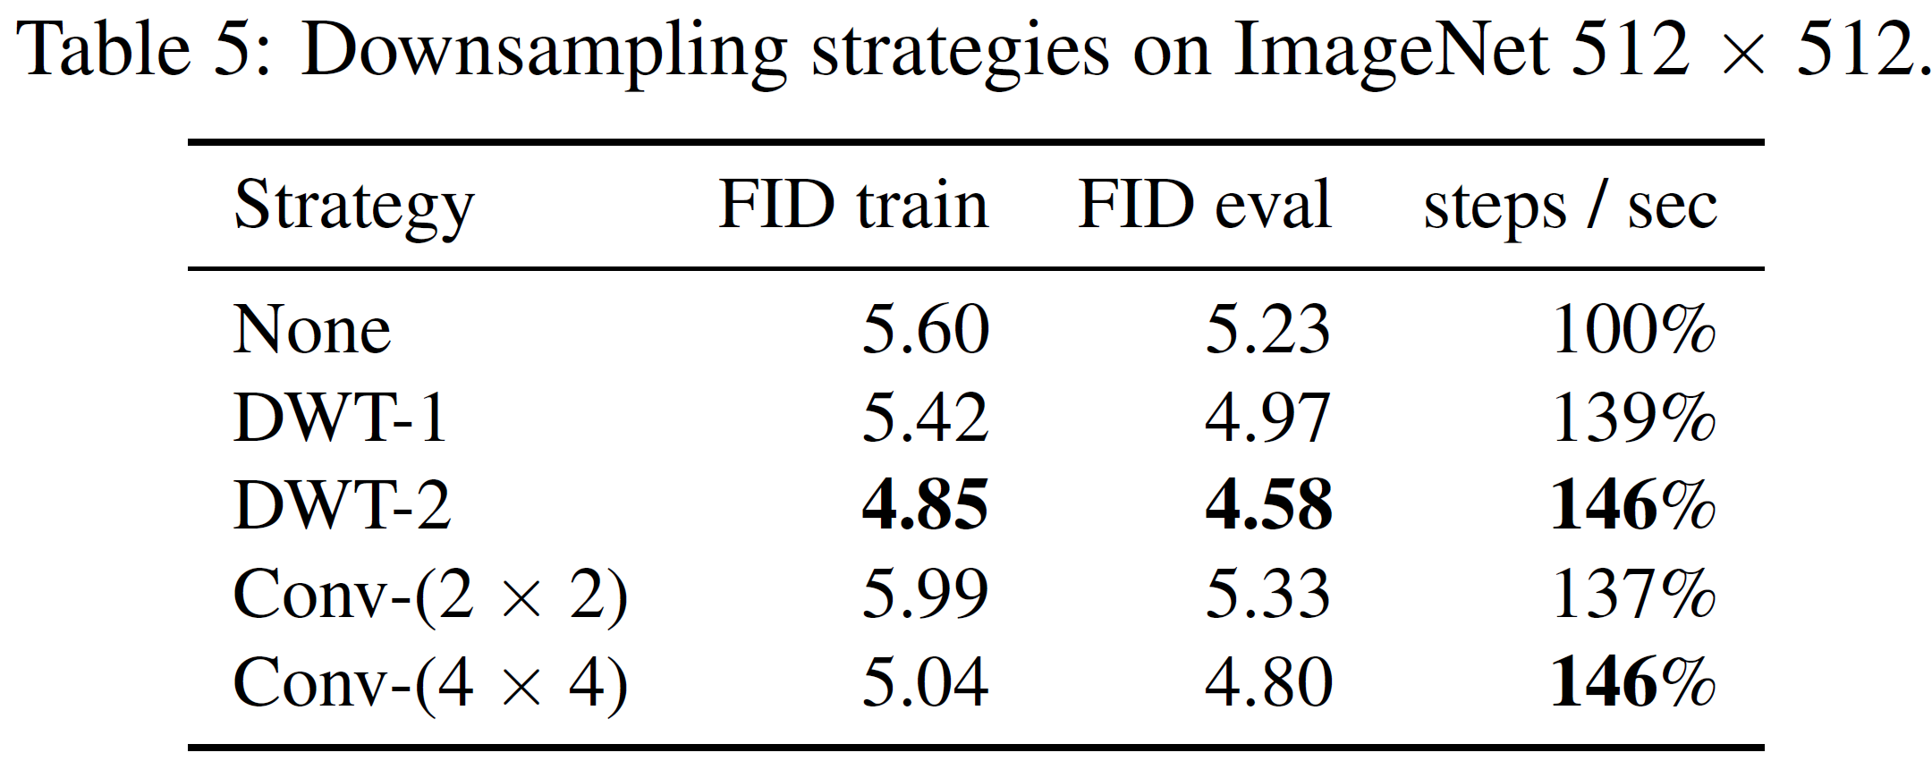
Experiment 4: Downsampling.
Hypothesis: reducing feature maps resolution (downsampling) after the first step leads to more efficiency.
2 downsampling strategies:
invertible and linear 5/3 wavelet
Convolution (dxd) with stride d
Notes:
Let’s start with a typical U-Net designed for 512x512 resolution images. From there, downsample is done to either 256x256 or 128x128, using convolutional layers or the Discrete Wavelet Transform (DWT).
The main hypothesis is that downsampling should not only maintain sample quality but also improve the model's efficiency.
The results are surprising. Models with downsampling not only ran faster but they also produced better-quality samples.
It seems that by downsampling these high-resolution feature maps, we allow the network to focus on what matters most, leading to more efficient optimization and better outputs. This approach also helps avoid the performance issues that can arise when dealing with excessively large feature maps.

Slide 13
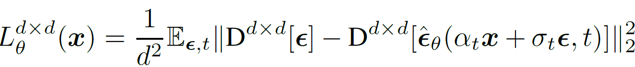
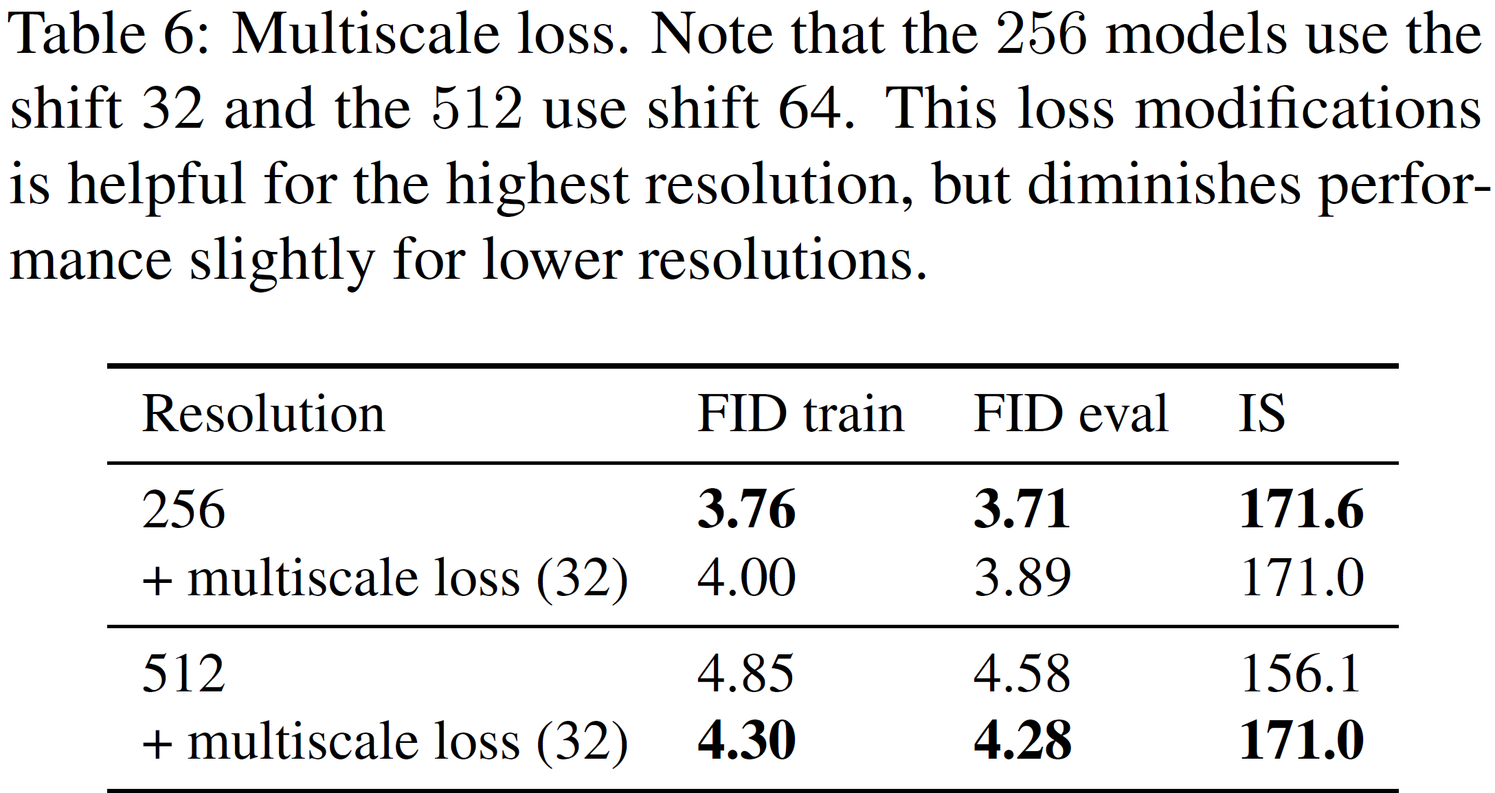
Experiment 5: Multiscale Loss.
Hypothesis: multiscale loss reduces the effect of the dominance of high frequency details in high resolution images and improves performance.
Notes:
Multiscale loss is a correction over the standard loss. This correction tries to reduce the effect of dominating high frequency details in high resolution images. To do so, it evaluates the standard training loss at downsampled resolutions with a weighting factor that increases for the lower resolutions.
As depicted in the Figure, at the 256 resolution, the multiscale loss didn't make much of a difference—in fact, it slightly underperformed compared to the conventional loss. But when we moved to the higher resolution of 512, the multiscale loss showed a significant impact.
This suggests that the multiscale approach might be more effective at higher resolutions, where focusing on broader frequency ranges can enhance the model's performance.

Slide 14
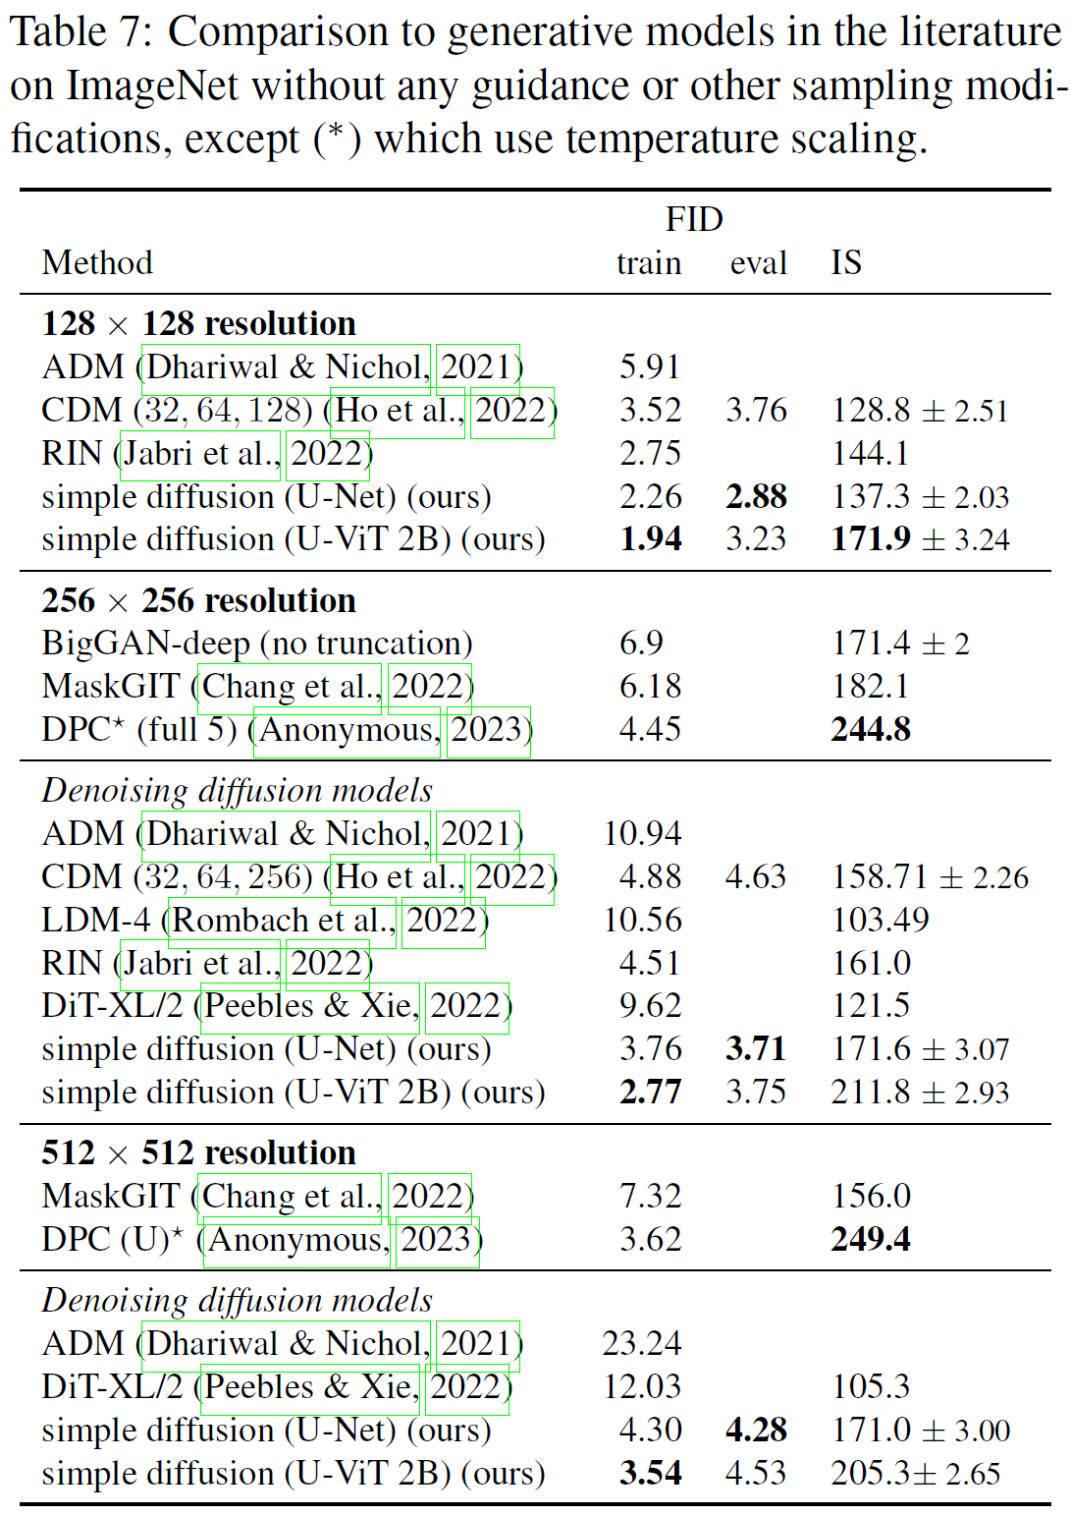
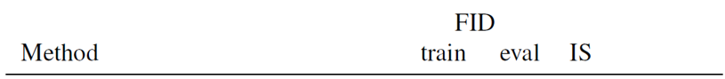
Experiment 6: SOTA Models Comparison
Hypothesis: Simple diffusion does it better than SOTA generative models in the literature on ImageNet without any guidance or other sampling modifications.
Notes:
Finally, a comparison against other models in the literature is performed. These models don't use guidance or other sampling tricks, like rejection sampling, to get a clearer sense of how well the models are inherently performing. Using these modifications can sometimes lead to artificially high visual quality scores.
Interestingly, the larger U-ViT models performed very well in terms of training FID and Inception Score (IS), surpassing all other methods reported in the literature.
However, when evaluating on test data, the U-Net models had better FID scores. This might reflect that increasing model size doesn't always improve eval FID.
Overall, simple diffusion achieves state-of-the-art FID scores for class-conditional ImageNet. This is an exciting result because it suggests that, with some adjustments to the diffusion schedule and loss function, simple diffusion can achieve high performance even at large resolutions like 512x512.

Slide 15
Conclusions
Superior Performance Without Guidance
Effectiveness of the Multiscale Loss
Selective Downsampling Improves Efficiency
Potential Lack of Flexibility
Notes:
1. Superior Performance Without Guidance
The simple diffusion model outperforms many existing approaches in terms of FID (Frechet Inception Distance) and Inception Score (IS) on ImageNet without using guidance or other sampling modifications.
2. Effectiveness of the Multiscale Loss
The multiscale loss, which emphasizes lower frequencies in the image, has a significant impact on model performance at higher resolutions.
3. Selective Downsampling Improves Efficiency
Downsampling methods help to redistribute high-resolution blocks to lower-resolution ones, significantly improving model efficiency without compromising sample quality. It also reduces the need for large feature maps, thus enhancing training efficiency and speed.
4. Drawback
while the simple diffusion model demonstrates strong performance without using guidance or other sampling modifications, it may not be as flexible in handling more complex image generation scenarios where guidance or other specialized techniques can offer improved control or customization.

Slide 16
Thank You!
Notes:
In this concluding experiment, we evaluate the disparity between the conventional loss and the multiscale loss, which places greater emphasis on lower frequencies within the image. We assess sample quality, measured by FID score, for resolutions 256 and 512, comparing models trained with the multiscale loss enabled or disabled. Figure 6 illustrates that for 256 resolution, the loss appears to have minimal impact and performs marginally worse. However, for the higher resolution of 512, the loss demonstrates a notable effect, resulting in a reduction in FID score.

